Slide 1
BUSINESS ANALYTICS MODEL RESULT COMMUNICATION
NAME: OKPANKU IJEOMA
COURSE: BAN 6880
BUSINESS ANALYTICS CAPSTONE
MILESTONE 2 ASSIGNMENT
COURSE ID:158862

Slide 2

INTRODUCTION
Business Analytics is a field that is centred on problem solving, focused on extracting insights and providing evidence based best practices to achieve desired outcomes all driven by data, for a business entity (Khatri, 2017). Going by this, a business problem was formed with the intentions of solving it. The business problem is on Inadequacies on Supply chain operations using Walmart as a case study.
This Photo by Unknown Author is licensed under CC BY-SA-NC

Slide 3
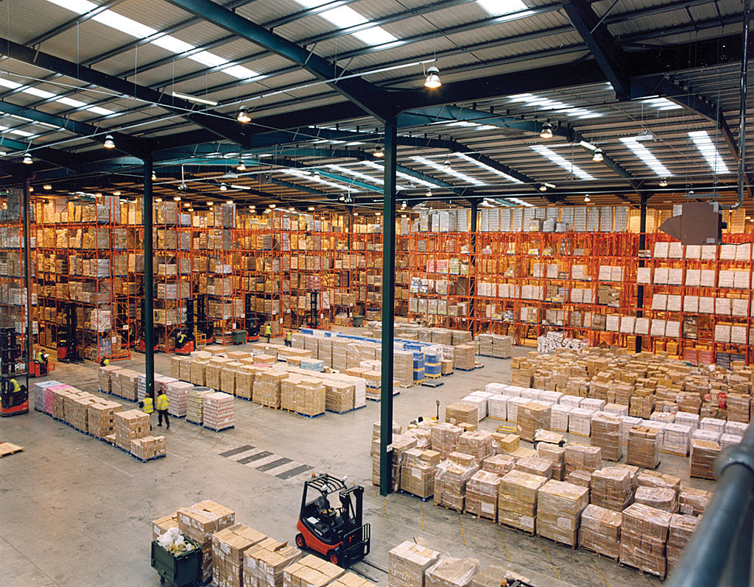
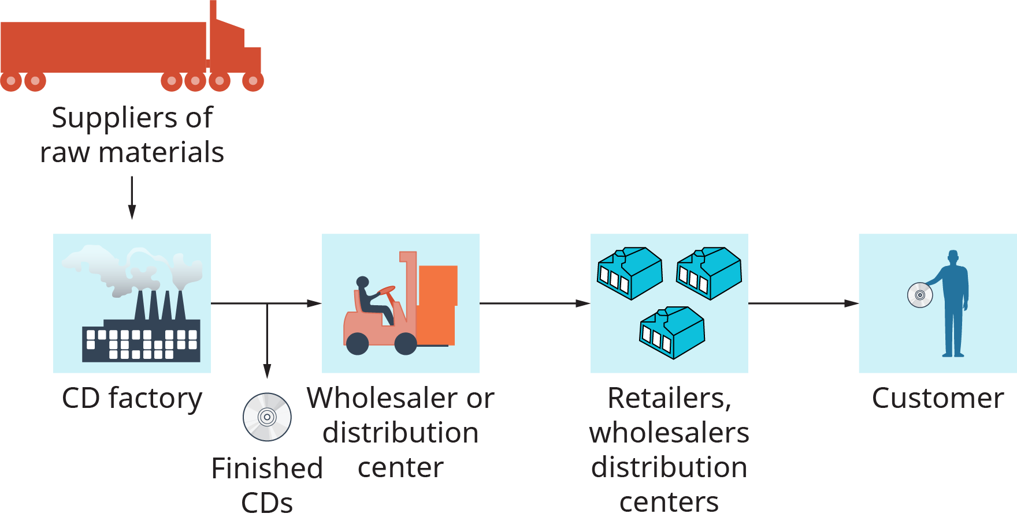
BRIEF VERVIEW OF WALMART
Walmart is one of the largest corporations that runs a retail model structure, it offers a wide range of products from groceries to electronics to general merchandise, with its presence in almost 23 countries The company operates a complex supply chain, and Optimizing the supply chain operations is key for Walmart to sustain its competitive edge and improve customer satisfaction and operational efficiency (Statista, 2024).
This Photo by Unknown Author is licensed under CC BY
This Photo by Unknown Author is licensed under CC BY

Slide 4
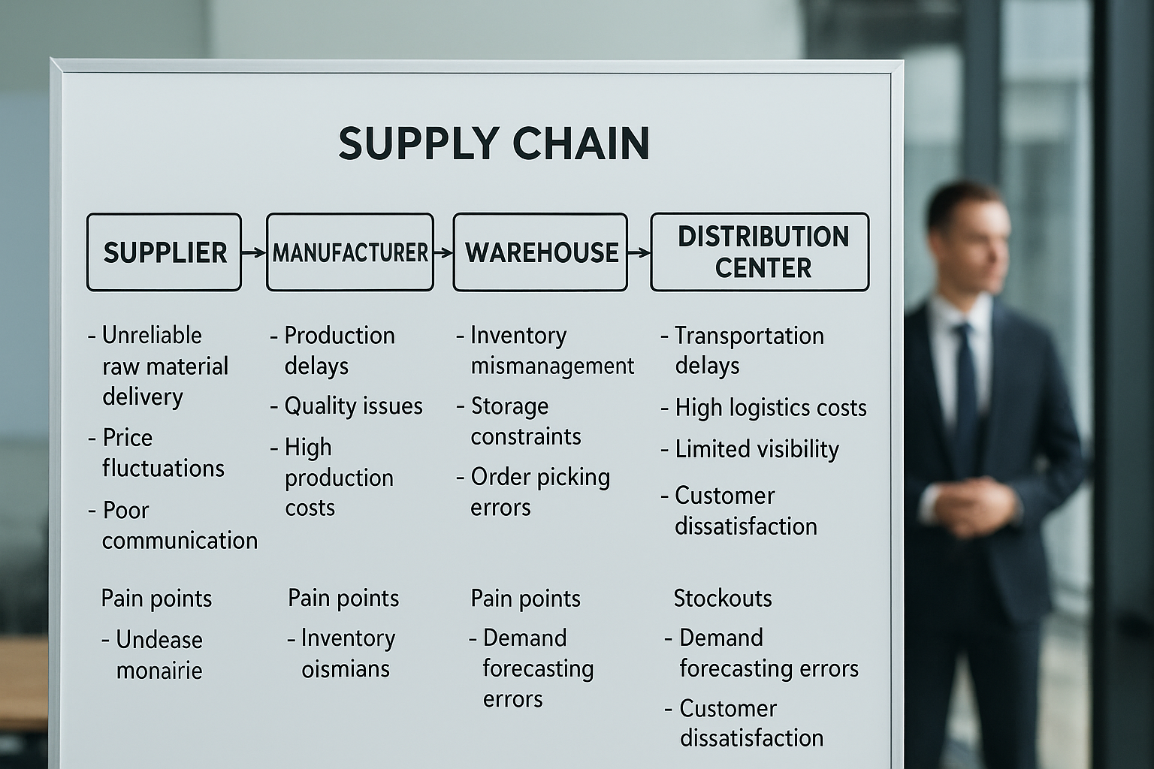
BUSINESS PROBLEM
This structure has faced challenges of inadequacies in its supply chain operations in such areas as.
Inventory management,
Logistics delays
Distributions Inefficiencies
therefore resulting in delay in reorder achievement, hike in operational cost, and reduced customer satisfaction.

Slide 5
OBJECTIVES
This project seeks to implement an advanced analytics platform leveraging on AI-driven supply chain analytics platform that would integrate predictive analytics, machine learning models, and real-time data streaming in other to achieve the following:
Reduce operational Cost
Improve Forecasting Accuracy
Enhance Supply Chain Visibility
Optimize Inventory Management
Improve Customer Satisfaction amongst others.

Slide 6

SOLUTION APPROACH
Data cleaning
Exploratory Data Analysis (EDA)
Feature Preprocessing and Engineering (Appinio Research, 2024)
Model Development Using RandomForest
Additional Evaluation was required:
- Cross Validation
- Feature Importance Analysis

Slide 7
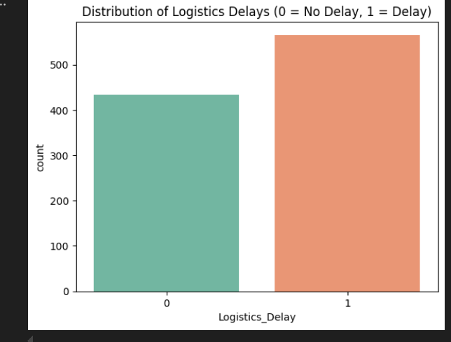
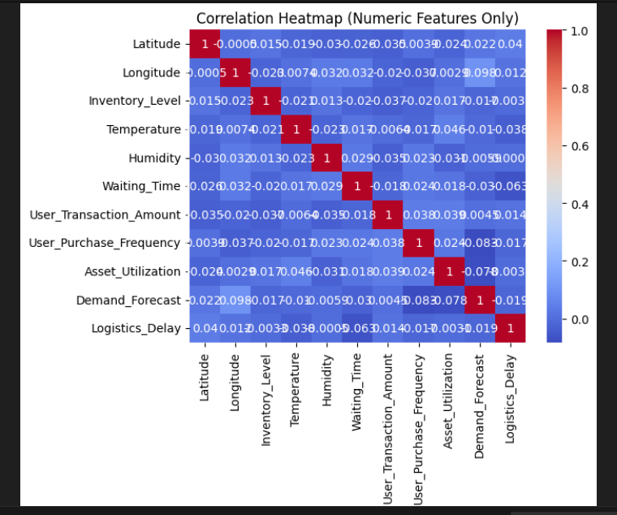
EXPLORATORY INSIGHTS
The following are deduced from the Exploratory Analysis
About 440 on time shipment
About 560 delayed Shipment representing about 56%
A strong correlation between shipment delay and Traffics, wait time etc.

Slide 8
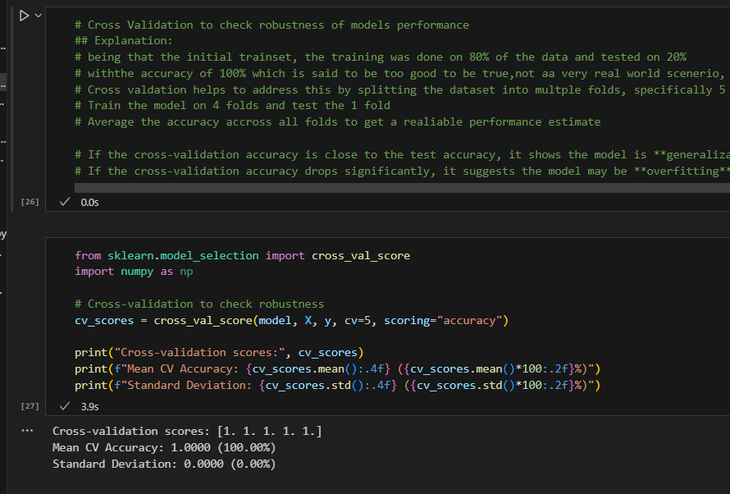
MODEL PERFORMANCE
Accuracy: Initial 100% was gotten
Cross Validation with stability consistency
strong predict performance

Slide 9
CONFUSION MATRIX
91 shipment without delay (Predicted correctly)
109 Shipment with delay (Predicted correctly)
No false predictions

Slide 10
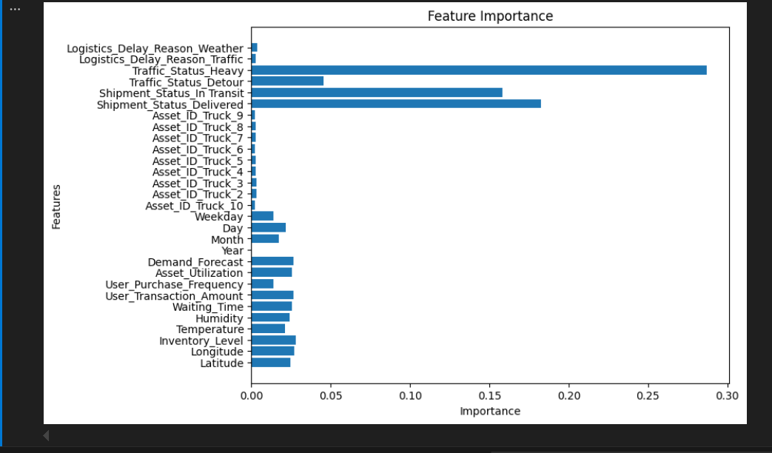
FEATURE IMPORTANCE ANALYSIS
Top Influencers of delays as shown by the Feature Importance Analysis are:
Traffic Status Heavy- very high
Traffic Status Detour- very high
Shipment Status in Transit - very high
Shipment Status Delivered – very high
Inventory level – moderate
Demand Forecast – relatively moderate
Waiting Time

Slide 11


BUSINESS VALUE
Early prediction of shipment delays enables proactive re-routing (as strategy to forestall impact) and scheduling, reducing the effect of traffic congestion, waiting times, and weather disruptions on delivery performance.
Summarily :
Early prediction → proactive re-routing & scheduling → fewer delays
Forestalling delays brings about educed operational cost
Increased rate of On time delivery builds customers trust, confidence & happy customer
This Photo by Unknown Author is licensed under CC BY-NC
This Photo by Unknown Author is licensed under CC BY-NC

Slide 12
CONCLUSION
Analysis showed that shipment delay of about 56% posed significantly operational challenges affecting deliveries.
Exploratory insights emphasized variables such as Traffic congestion, shipment status, waiting time, demand forecast, inventory level as both major and moderate drivers of delays.
Classification model achieved excellent predictive performance with a stable result achieved in a cross validation evaluation, while feature Importance Analysis identified key influencer variables.
In conclusion, Predictive modelling can stand as strong tool for early detection of delays, Proactive interventions such as re-routing, optimized scheduling in a bit to enhance logistics efficiencies thereby bringing customer satisfaction.

Slide 13
RECOMMENDATION
Leverage early predictions: by the use of supervised machine learning classification model (Decision Tree / Random Forest) to predict shipment delays in advance.
Streamline hub operations to reduce waiting time by :
Introducing Automated processed like the use of conveyors, robotic systems
Effective Resource allocation
Real time monitoring to monitor shipment at hubs.
Effective Scheduling.
Further Model Validation: Continue testing the model using the stratified k-fold or train/validation/test split, then on new or external datasets ( if need be) to ensure reliability and generalization in real-world settings

Slide 14
References
Appinio Research. (2024, March 21). What is Predictive Modeling? Types, Techniques | Appinio Blog. Appinio.com; Appinio GmbH. https://www.appinio.com/en/blog/market-research/predictive-modeling
Kaggle. (2024). Datasets | Kaggle. Kaggle.com. https://www.kaggle.com/datasets
Khatri, V. (2017, October 20). Business Analytics. Benchmark Six Sigma Forum. https://www.benchmarksixsigma.com/forum/topic/34901-business-analytics/
Statista. (2024). Topic: Walmart. Www.statista.com; Statista. https://www.statista.com/topics/1451/walmart/

